Slide 1
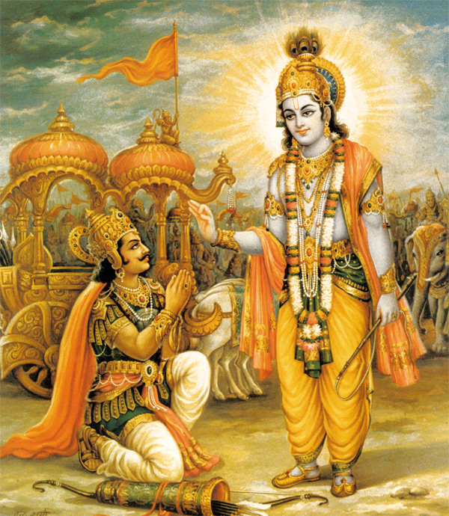
Bhagavad Gita Chapter-8 Summary Attaining the Supreme May 1st 2015

Slide 2
Sections and Verses
8.1 to 8.4 | Arjuna asking Questions and Krishna Answering
8.5to 8.8 | Going back to Godhead Remembering Krishna
8.9 to 8.13 | Remembering Krishna
8.14 to 8.16 | Pure Devotional Service
8.17 to 8.22 | Comparing the material and spiritual worlds
8.23 to 8.28 | The supremacy of devotional service
Notes:
The chapter is divided into 6 sections…

Slide 3
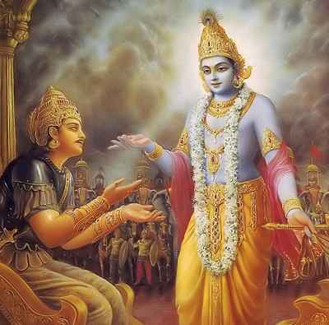
8.1 to 8.4
Arjuna Asking Questions
&
Krishna Answering
Notes:
The first section is 8.1 to 8.4….

Slide 4
Arjuna Asks Eight Questions
Addresses Krishna as Puroshottama (Supreme Person) and as Madhusudana (slayer of demons – in this case the demons of doubt he has)
What is Brahman?
What is the Adhyatman?
What is Karma?
What is Adhibutam?
What is Adideivam ?
What is Adiyajna ?
How does he live in the body?
How can those engaged in Devotional service know Krishna at the time of death?
Notes:
In the end of the previous chapter the Lord introduced some new terms… So, in the 8th chapter Arjuna begins by asking the Lord for the clarification of those terms.

Slide 5
Krishna Answers
Brahman: The Indestructible, eternally existing transcendental living entity (different from Para-Brahman, the Supreme Personality of Godhead)
Adhyatman: Self – The eternal nature of living entities (the Soul in the body)
Karma : These are the fruitive activities performed by the living entities
Adibhutam: The material manifestation that is constantly changing
Adideivam: The universal form of the Lord that includes all other demigods
Adiyajna: The Supersoul
How does he live in the body: He lives in the heart of every embodied being
Attaining him at the time of death: Whosoever at the end of his life quits his body remembering only the Lord attains him.
Notes:
Krishna answers the first 7 questions in four verses and takes the whole chapter to answer the 8th question because that is the most important question….

Slide 6
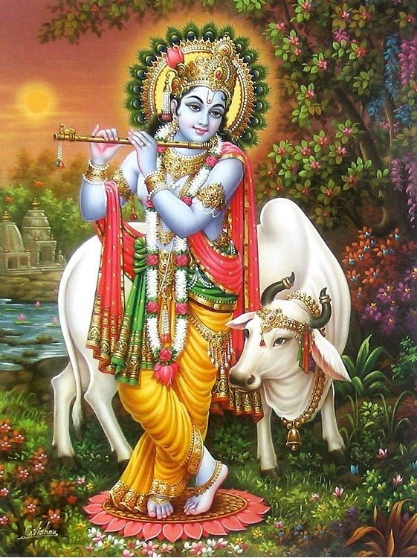
8.5 to 8.8
Going back to Godhead
Remembering Krishna
Notes:
In this section the Lord is Explaining how one can go back to him by remembering him at the time of death….

Slide 7
At the time of death ..
He who remembers Krishna at the time of death will not be reborn and at once attains his nature
Krishna emphasizes the importance of Krishna Consciousness
Remembrance of Krishna at the time of death is not possible if one has not practiced to remember him all the time
Therefore one should constantly practice Maha Mantra, leads to constant thinking of the Lord, even at the time of death, thus attaining the Supreme Lord and his planet
Remembering him all the time while doing one’s prescribed duties
All senses engaged in the service of Krishna
Whatever one remembers at the time of death they get to experience that in the next life
Bharata thought of a deer at the time of death, and so was reborn as a deer
Krishna asks Arjuna to think of him and carry out his prescribed duties. Dedicate one’s activities and fix one’s mind and intelligence on him, and one will attain me, without doubt
Remembering him all the time while doing one’s prescribed duties
All senses engaged in the service of Krishna(chanting, hearing, going to the temple etc….)
Example of caterpillar. It thinks of becoming the butterfly and thus becomes one at the end of its life. Similarly think of Krishna

Slide 8
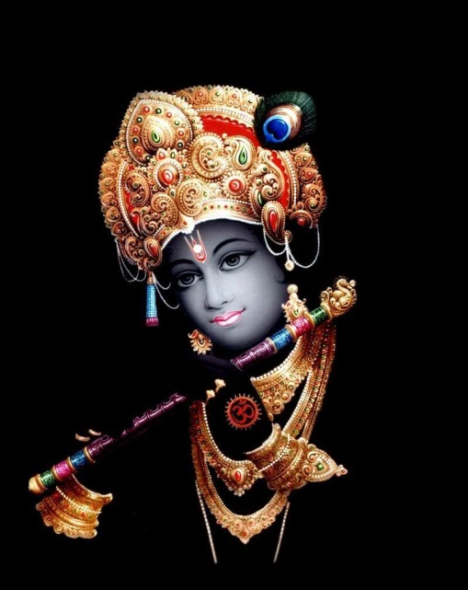
8.9 to 8.13
Remembering Krishna
Notes:
In this section Krishna talks more about how to remember him …

Slide 9
Meditate on the Lord as one who..
Knows everything (past, present, future)- Kavi
Oldest – origin of everything (everything is born out of him)
Supreme Controller of the Universe
Smaller than the smallest
Maintainer of all planetary systems
Beyond all material conception
Inconceivable
Always a person(meditating on something impersonal or void is difficult)
Luminous like the sun
Transcendental, beyond material nature
Notes:
The process of thinking of the supreme is mentioned in verse 9….
Smaller than the smallest One-ten thousandth part of the tip of a hair

Slide 10
Serving the lord as a Yogi Yogamishra Bhakti
Yogis should raise the life force between the eye-brows (ajna-chakra)- practice of sat-chakra-yoga
Learned in the Vedas, uttering Om-kara, renunciates, practicing celibacy, enter into Brahman – practices of impersonalists
Yogis detach from sensual engagements and think of the Supreme Personality of Godhead
This will take them to the spiritual planets, if successfully done
Notes:
Here, the lord also talks about Yoga Mishra bhakti and gives a contrast to pure bhakti yoga to show that it is not practical in today’s world to
be a yogi…

Slide 11
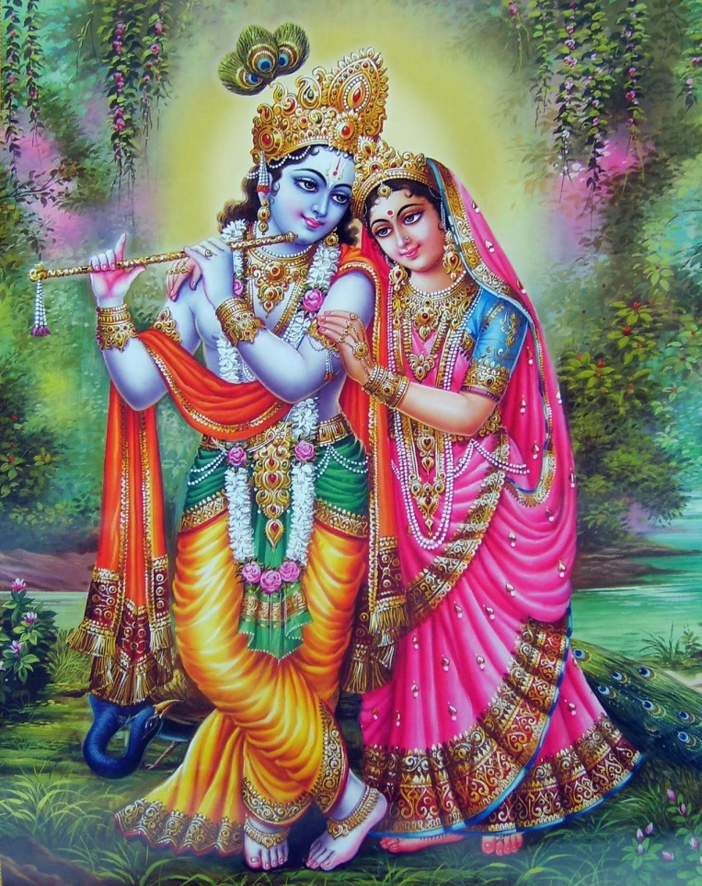
8.14 to 8.16
Pure Devotional Service

Slide 12
Bhakti Yogis Practitioners of Krishna Consciousness
Bhakti yogis (practitioners of KC) do not need to practice such yoga
They practice unalloyed devotion, remembering and serving the lord
Chant the holy name of the Lord
Bhakti Yogis in devotion never return to this temporary world
Only he who attains the abode of Supreme Personality of Godhead does not return. All the planets (highest to lowest) in the material world are places of misery where the cycle of birth and death occurs.
Notes:
On the other hand, the Bhakti Yogis do not need to practice such yoga….

Slide 13
Five Primary Ways Engaging in Devotional Services…
Practice Bhakti yoga as a….
Santa Bhakta: Neutral
Dasya Bhakta : Servitor
Sakhya Bhakta: Friendship
Vathsalya Bhakta: Parental Love
Madhurya Bhakta: Conjugal Love
Notes:
One Engages in devotional services in different ways…

Slide 14
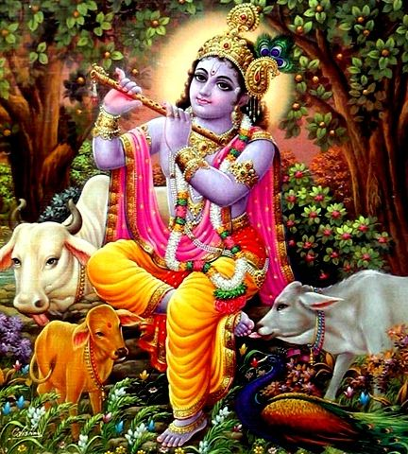
8.17 to 8.22
Comparing the Material and
Spiritual World

Slide 15
Cyclic Creation and Annihilation
All Material entities get manifested at the beginning of Brahma’s day (a kalpa)
1000 cycles of 4 yugas (Satya, Treta, Dwapara, Kali)
At the night all are merged into unmanifest state again

Slide 16
Abode beyond Manifest and Unmanifest
The supreme abode of the Lord neither gets manifest nor annihilated
This is the supreme destination
Having attained this one never returns
One can reach there by unalloyed devotion
Although he is in his abode he is all pervading and everything is situated within him
Notes:
The supreme abode is transcendental

Slide 17
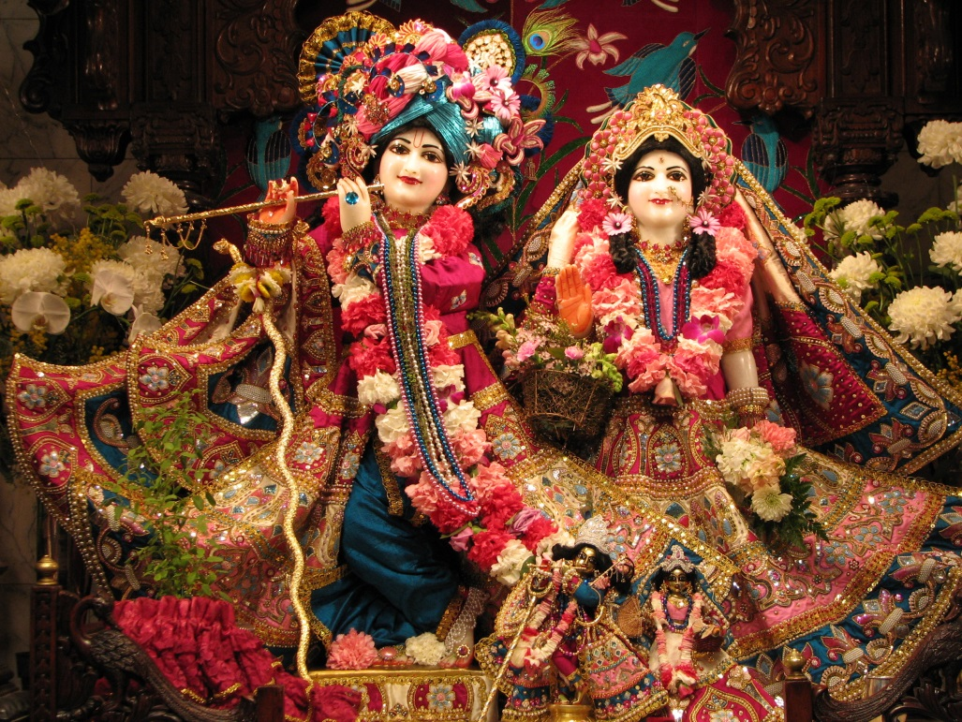
8.23 to 8.28
Supremacy of Devotional Service
Notes:
In this section Krishna explains two ways of passing away and how a Krishna Conscious devotee is not bewildered by these and continues his devotion to the Lord

Slide 18
The Passing away of a Yogi
A yogi who passes away in the day, on an auspicious moment during the fortnight of waxing moon or during the six months when the sun travel in the north attains Brahman
A yogi who passes away from this world during the night , the fortnight of the waning moon or six months when the sun travels in the south reaches the moon planet but again comes back to the material world
The Krishna Conscious devotee can pass away at any time, anywhere, however
Notes:
.

Slide 19
State of a Devotee
He knows these two paths
Never gets bewildered
Always fixed in devotion
He is not bereft of the results derived from studying the Vedas, performing sacrifices, undergoing austerities, giving charity or pursuing philosophical and fruitive activities.
Notes:
By following Krishna Consciousness one can surpass all the rituals one has to do in all different orders of life brahmacharya, householder, vanaprasta and sanyasa as prescribed in the Karma Kanda portion of the Vedas. But he will get the benefit of all those just by following the path of devotional service. This is explained in verse 28….

Slide 20
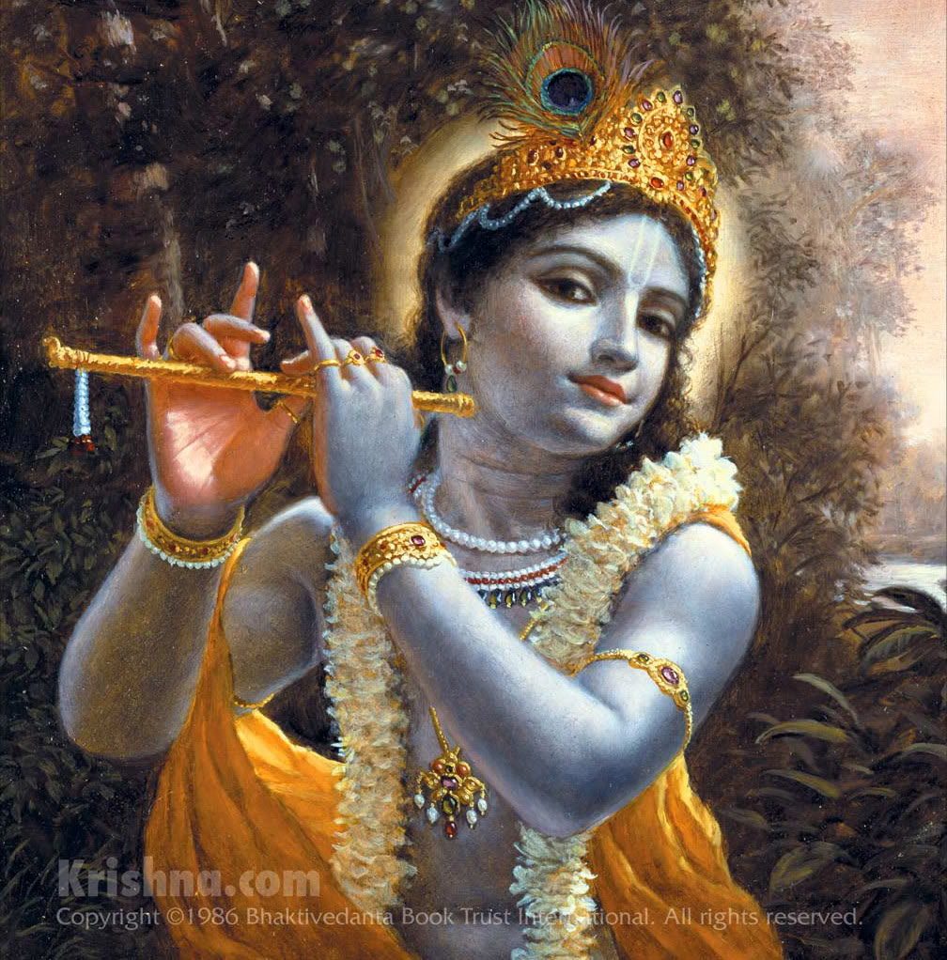
Stages of Bhakti
Prema
Bhava
Asakti
Ruchi
Nista
Anartha Nivriti
Bajana Kriya
Sadhu sanga
Sraddha
Notes:
A devotee attains that state of pure love for Krishna by steadily going up the Stages of Bhakti….
Sraddha- faith; Sadhu Sanga- association of devotees ; Bajana Kriya: performance devotional services under the guidance of spiritual master ; Anartha Nivriti - decreasing of unwanted attchments; Nista – steadiness in devotional services ; Ruchi – developing a taste in hearing about Krishna ; Asakti – Attachment to Krishna ; Bhava – further attachment to Krishna Consciousness; Prema – pure love for Krishna

